Slide 1

Software Architecture And Design
Sec.2
Eng. Al-hassan Mohamed
Eng. Mariam Malak

Slide 2

AGENDA
Agenda
Reading url
Endpoint structure
Files structure
HTML, CSS, JS and Bootstrap
JINJA

Slide 3

Reading routes

Slide 4
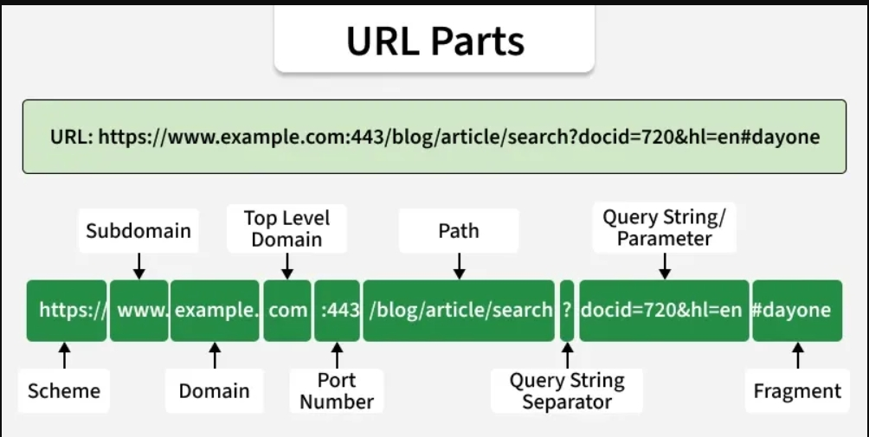
URL components
Scheme: Defines the protocol used to access the resource (e.g., http, https, ftp).
Subdomain: Specifies a subdivision of the main domain (e.g., www).
Domain: Identifies the main website name (e.g., example).
Top-Level Domain (TLD): Indicates the domain extension (e.g., .com, .org).
Port Number: Specifies the server port (default: 80 for HTTP, 443 for HTTPS).
Path: Points to the resource location on the server.
Query String Separator: The ? symbol that starts query parameters.
Query String / Parameters: Passes data as key–value pairs using &.

Slide 5



URL components
To ask for specific page
Domain
IP
Port
number
Api’s route

Slide 6
Endpoint structure

Slide 7
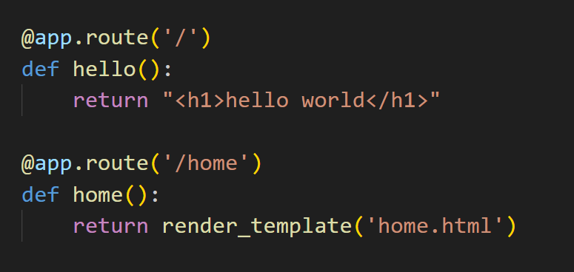
Endpoint structure
@app → our object from Flask class
route → defining the last part of the url and through it we define if the api needs parameters or not to be sent through the url.
‘/ ‘ or ‘/home’ → your url to call this api
render_template(‘home.html’) → to go to specific web page when running this api instead of white page.
The default request method is GET method

Slide 8
File structure

Slide 9
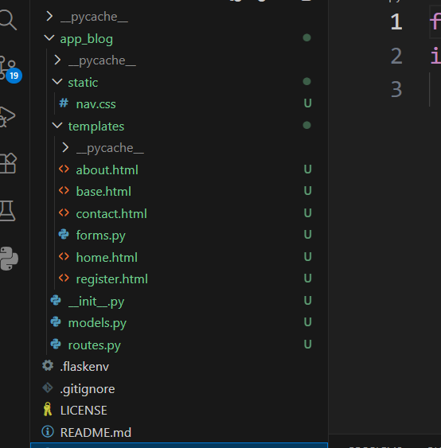
File structure
We create “static” folder → to put all css files, images, and js files in it , which means we put all files that are static to the project.
This file has one valid name which is “static”, don’t change it because flask search for it with that name to load all static files
We create “templates” folder → to put all our templates which are html files
Any other file is outside these folders

Slide 10
HTML, CSS, JS and Bootstrap

Slide 11
Home page for “job portal” project
First, create “.html” file in template folder and name it.
Design your home page.
Add css, js and images in static folder
To connect them correctly →
<link href="{{ url_for('static', filename=‘/css/style.css') }}" rel="stylesheet">
<link href="{{ url_for('static', filename=‘/img/carousel-1.jpg'}}" rel="stylesheet">
<link href="{{ url_for('static', filename=‘/js/main.js') }}" rel="stylesheet">
To make api return the home page not a white one , we use “render_template(home.html’)” [DON’T forget import it from flask]

Slide 12
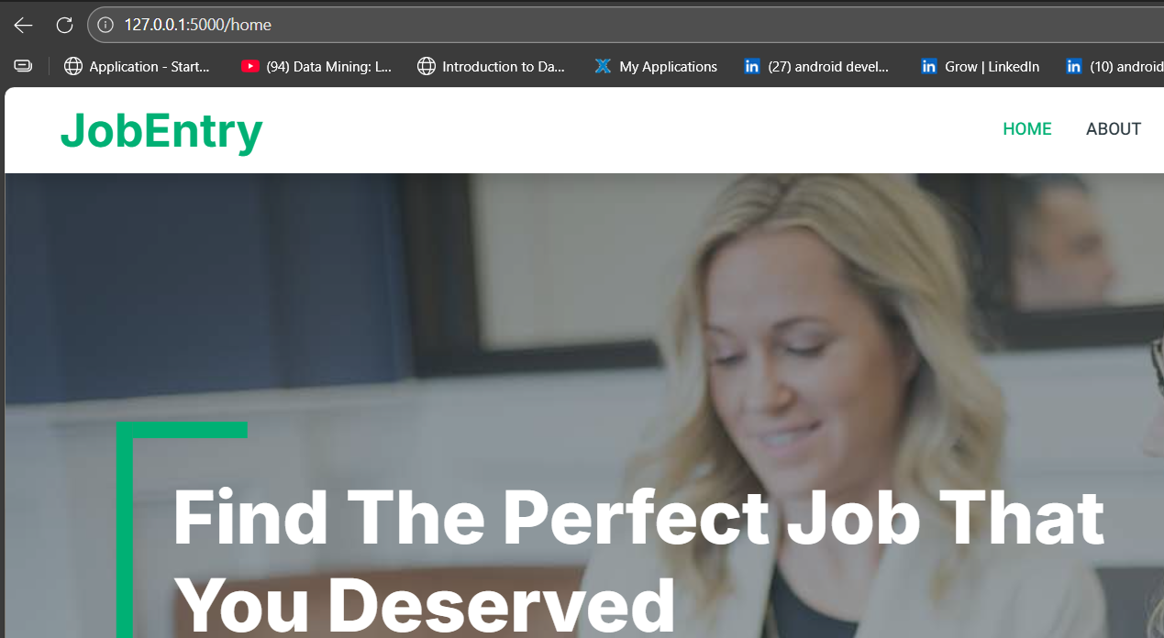
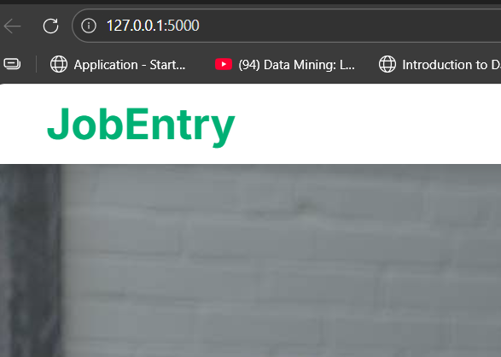
Home page for “job portal” project
Now, we want to convert from this:
To this with the same output
[changing default page ]:

Slide 13
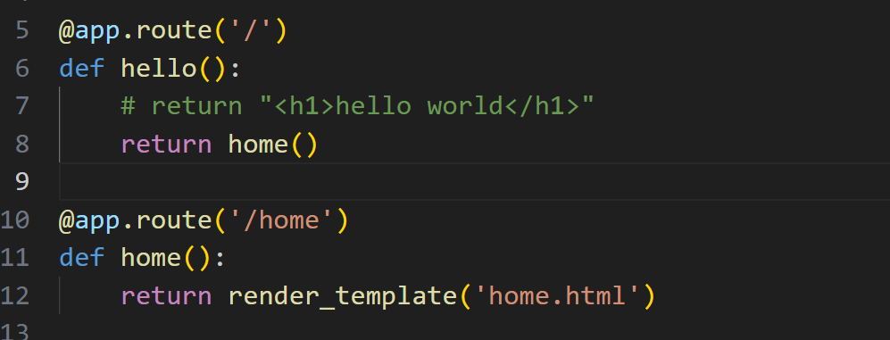
Home page for “job portal” project
We’ll do this:

Slide 14
jinja

Slide 15
JINJA
Jinja is a template engine
Template engine means that we can use the power of programming in HTML files
[equal to Razor in C# MVC]
Enable writing python code in html to ease using data in html.
How do we do that??

Slide 16
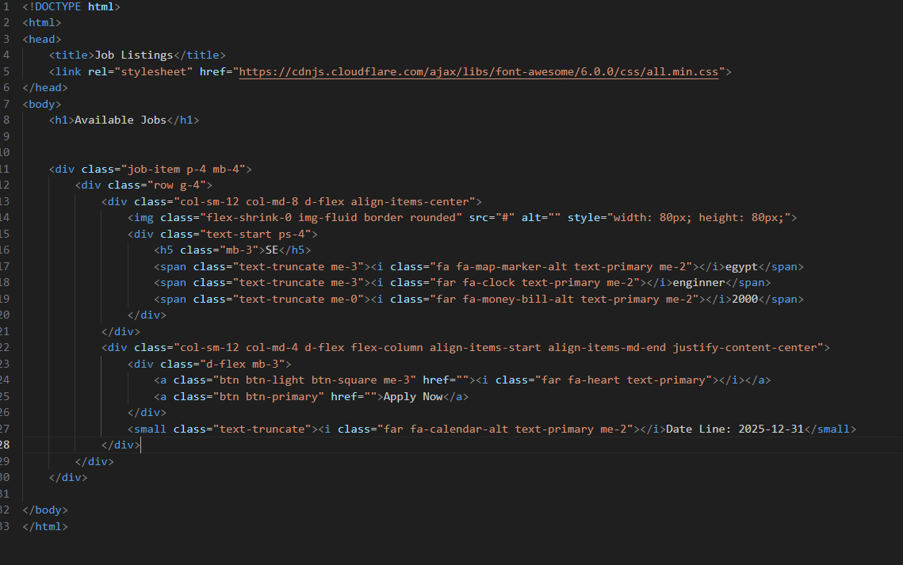
JINJA
We’ll create a job list page to show list of jobs
First, we’ll create page structure “jop-list.html”

Slide 17
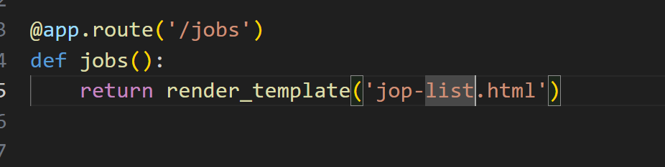
JINJA
Create its end point:

Slide 18
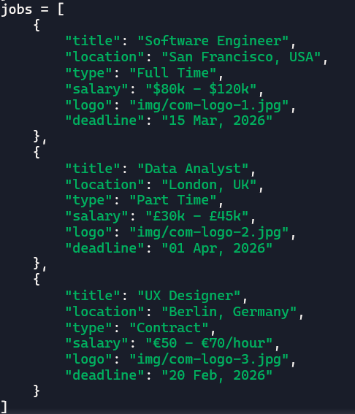
JINJA
Add custom list of dictionaries of data to your project:
Notes:
jobs = [
{
"title": "Software Engineer",
"location": "San Francisco, USA",
"type": "Full Time",
"salary": "$80k - $120k",
"logo": "img/com-logo-1.jpg",
"deadline": "15 Mar, 2026"
},
{
"title": "Data Analyst",
"location": "London, UK",
"type": "Part Time",
"salary": "£30k - £45k",
"logo": "img/com-logo-2.jpg",
"deadline": "01 Apr, 2026"
},
{
"title": "UX Designer",
"location": "Berlin, Germany",
"type": "Contract",
"salary": "€50 - €70/hour",
"logo": "img/com-logo-3.jpg",
"deadline": "20 Feb, 2026"
}
]

Slide 19
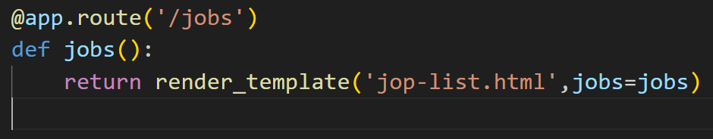
JINJA
Send the data to the page and name it with a name we will use it in the html:
We use this name as reference for the list to use it in html file
Notes:
jobs = [
{
"title": "Software Engineer",
"location": "San Francisco, USA",
"type": "Full Time",
"salary": "$80k - $120k",
"logo": "img/com-logo-1.jpg",
"deadline": "15 Mar, 2026"
},
{
"title": "Data Analyst",
"location": "London, UK",
"type": "Part Time",
"salary": "£30k - £45k",
"logo": "img/com-logo-2.jpg",
"deadline": "01 Apr, 2026"
},
{
"title": "UX Designer",
"location": "Berlin, Germany",
"type": "Contract",
"salary": "€50 - €70/hour",
"logo": "img/com-logo-3.jpg",
"deadline": "20 Feb, 2026"
}
]

Slide 20
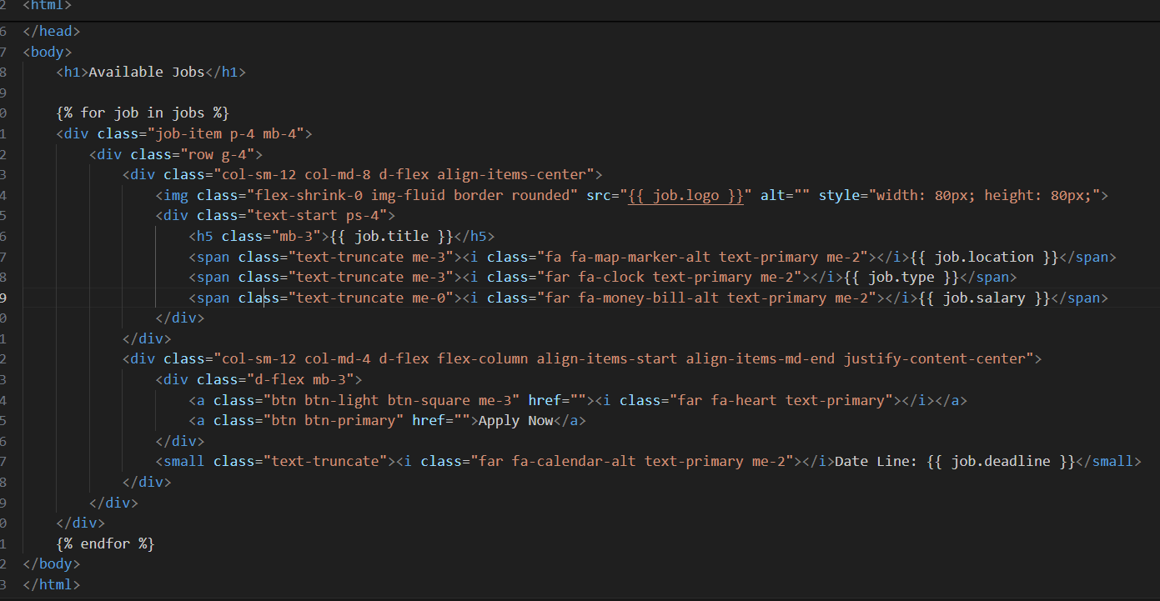
JINJA
Go to html and loop through the list:
Loop over design by size of jobs list
End of loop
Notes:
% , {{item}}→ JINJA way to deal with data

Slide 21

THANK YOU

